Slide 1

Type Conversion

Slide 2
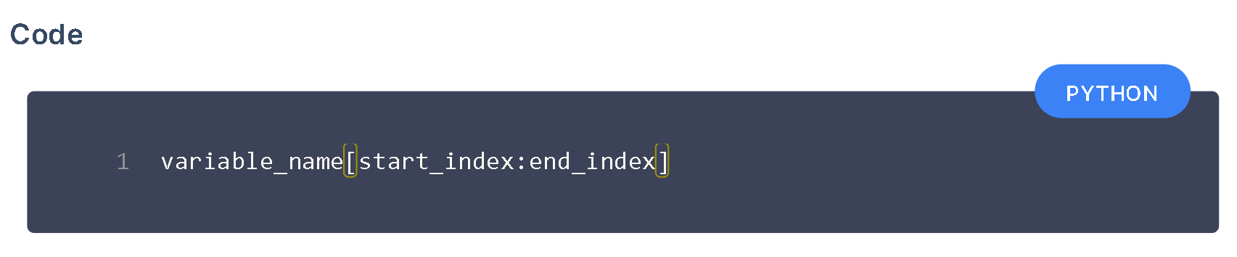
String Slicing
Obtaining a part of a string is called string slicing.
Start from the start_index and stops at end_index
end_index is not included in the slice.

Slide 3
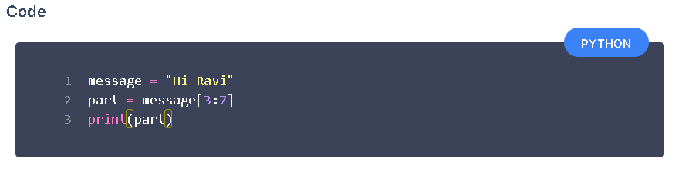
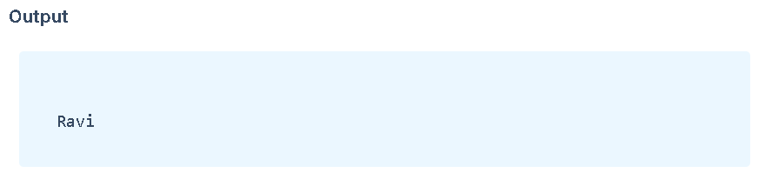
Example

Slide 4
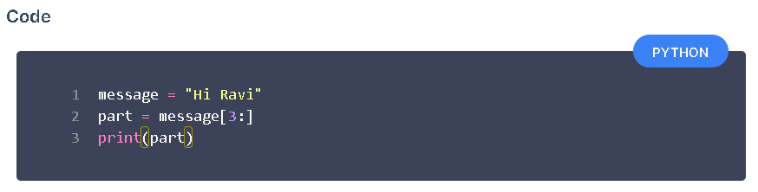
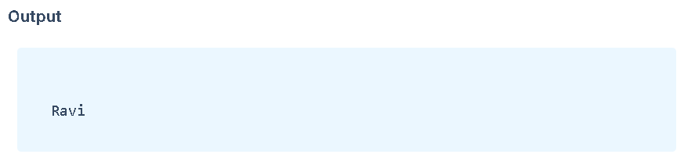
Slicing to End
If end index is not specified, slicing stops at the end of the string.

Slide 5

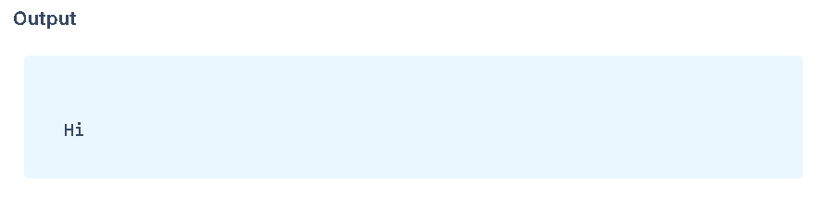
Slicing from Start
If start index is not specified, slicing starts from the index 0.

Slide 6

Checking Data Type
Check the datatype of the variable or value using type()

Slide 7
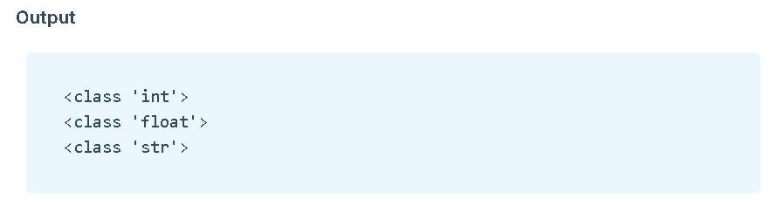
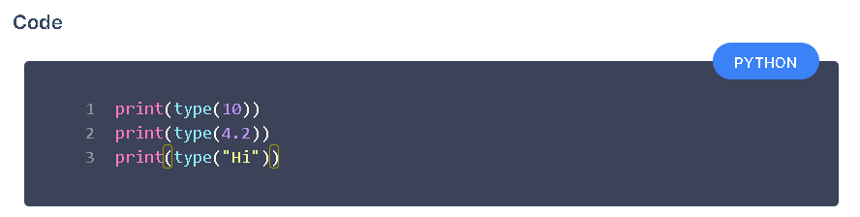
Printing Data Type

Slide 8

Type Conversion
Converting the value of one data type to another data type is called Type Conversion or Type Casting.
We can convert
*String to Integer
*Integer to Float
*Float to String and so on.

Slide 9
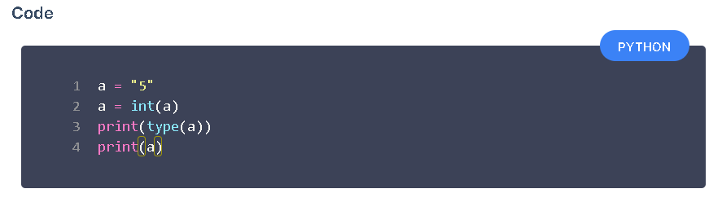
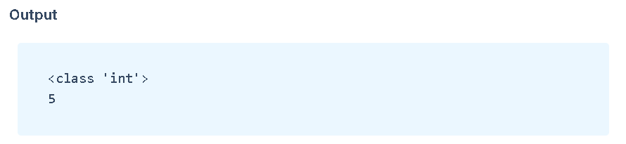
String to Integer
int() converts valid data of any type to integer

Slide 10
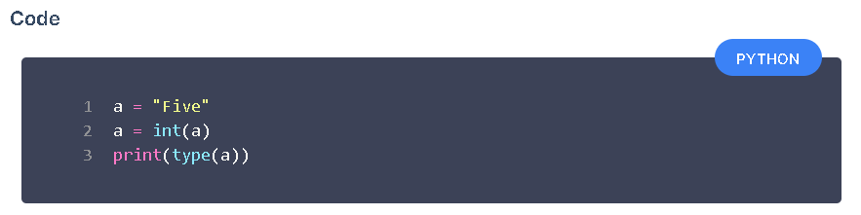
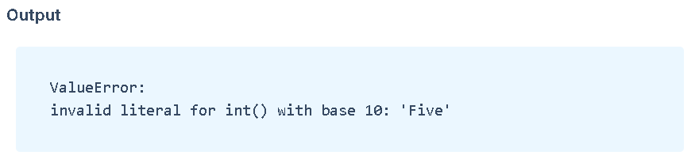
Invalid Integer Conversion

Slide 11
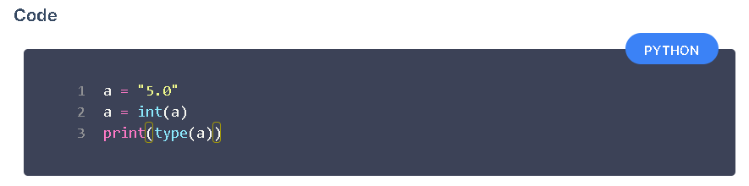
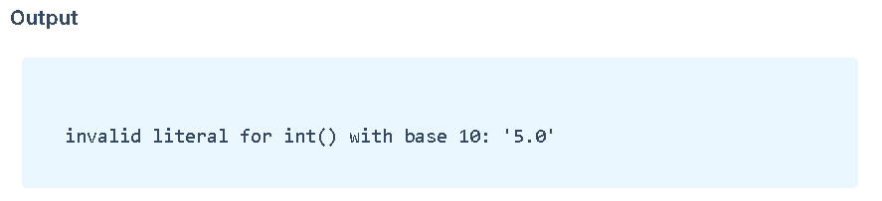
Example

Slide 12
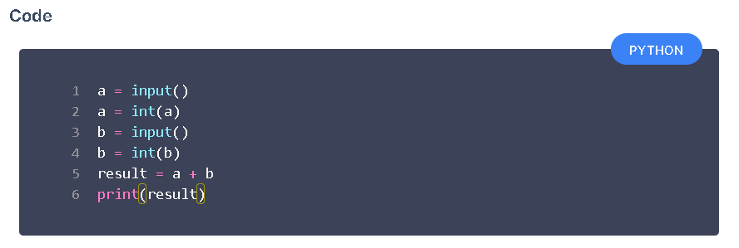
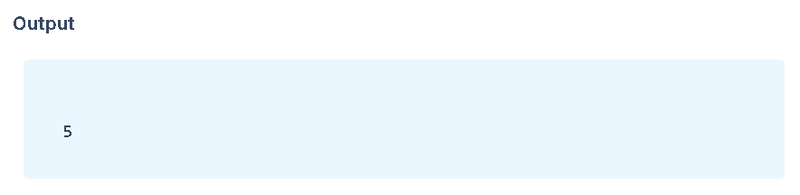
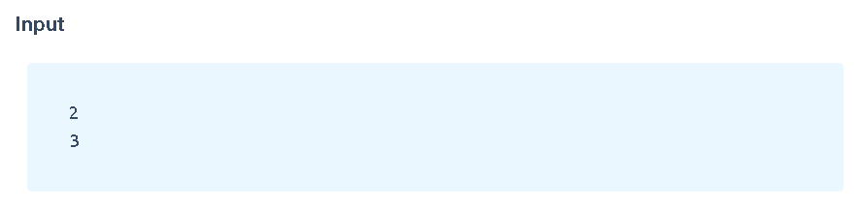
Adding Two Numbers

Slide 13
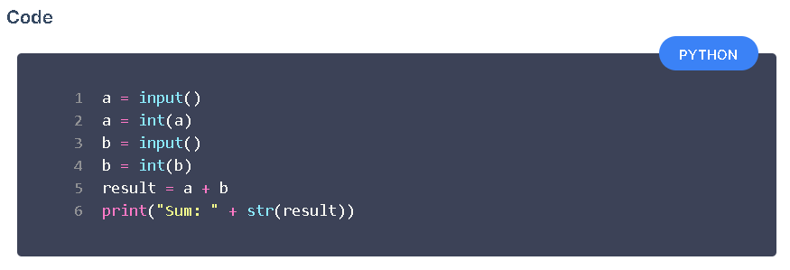
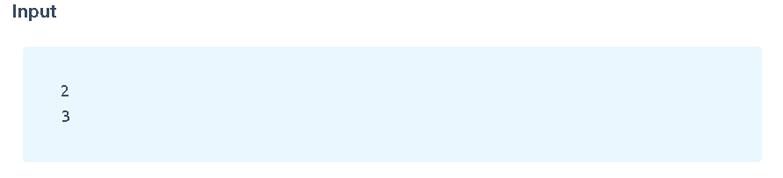
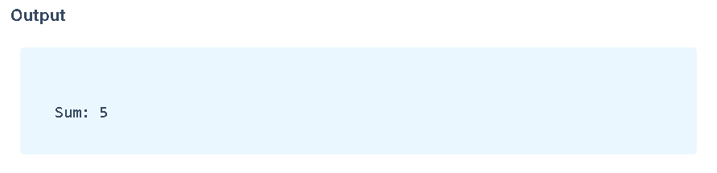
Integer to String
str() converts data of any type to a string.

Slide 14
int() -> Converts to integer data type
float() -> Converts to float data type
str() -> Converts to string data type
bool() -> Converts to boolean data type

Slide 15

Relational Operators

Slide 16
Relational Operators
Relational Operators are used to compare values.
Gives True or False as the result of a comparison.

Slide 17
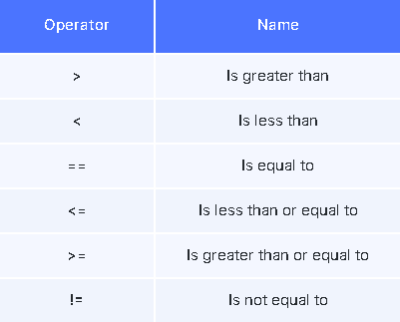
These are different relational operators

Slide 18
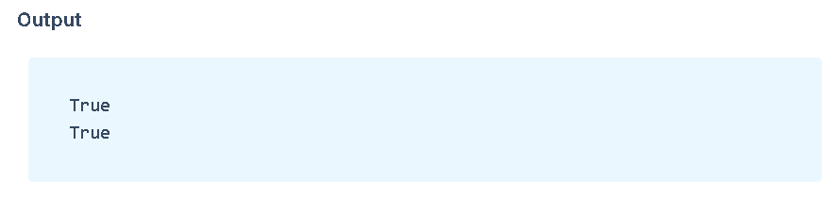
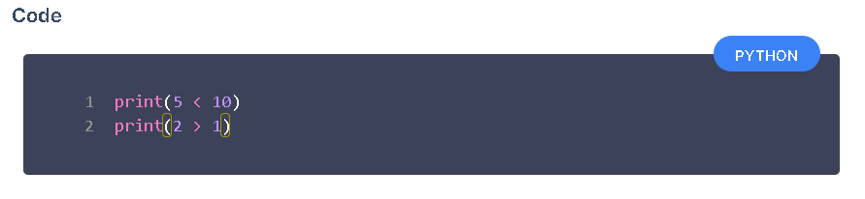
Example

Slide 19
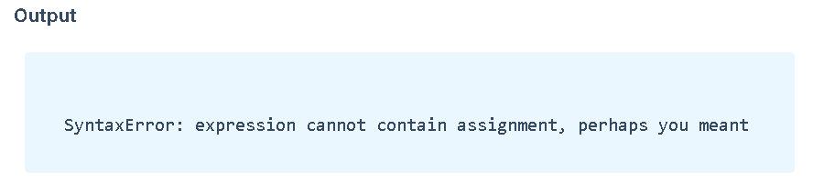
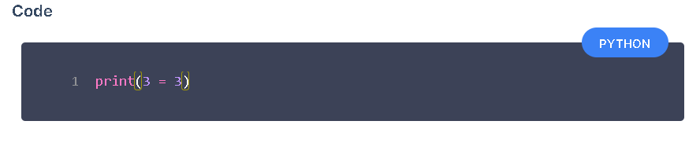
Possible Mistakes Mistake - 1

Slide 20
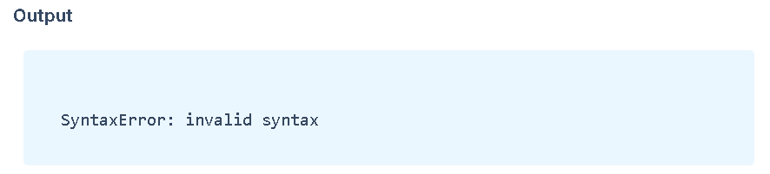
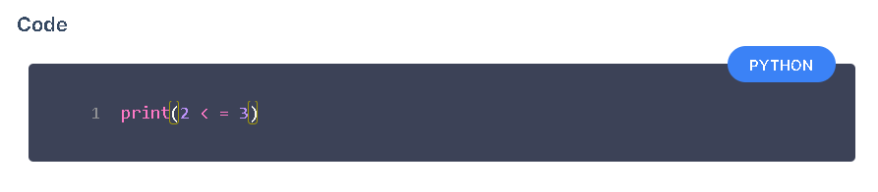
Mistake - 2
Space between relational operators == , >= , <= , != is not valid in Python.

Slide 21
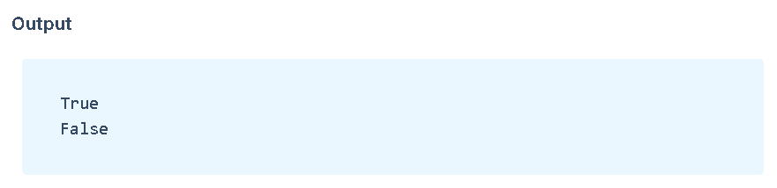
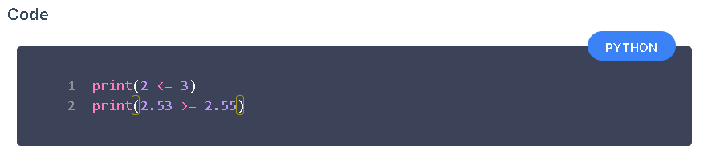
Comparing Numbers

Slide 22
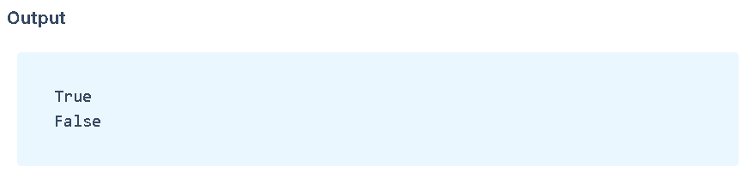
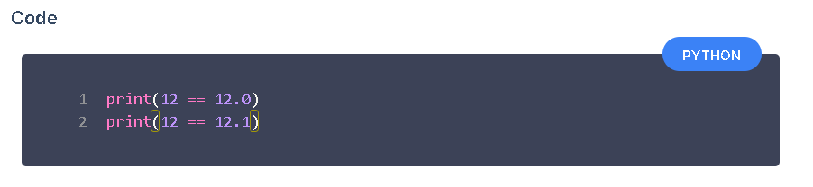
Comparing Integers and Floats

Slide 23

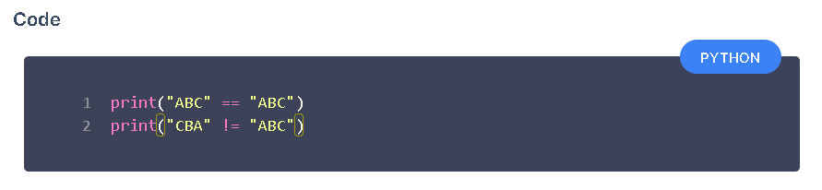
Comparing Strings

Slide 24
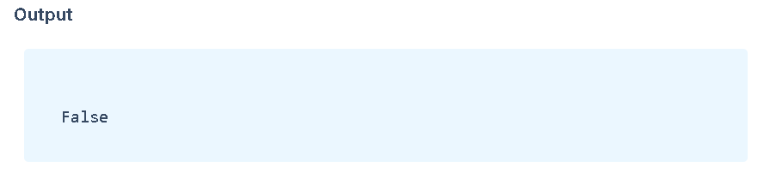
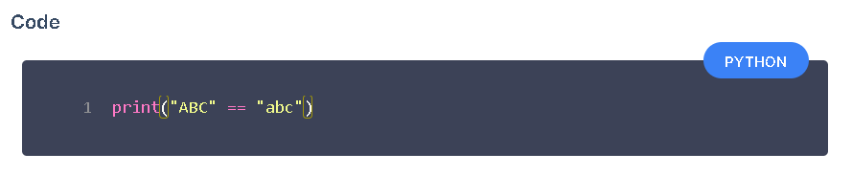
Case Sensitive
Python is case sensitive. It means X (Capital letter) and x (small letter) are not the same in Python.

Slide 25
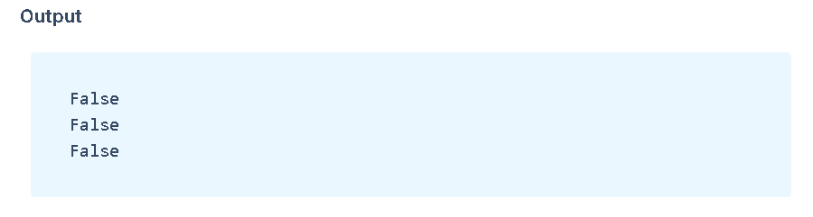
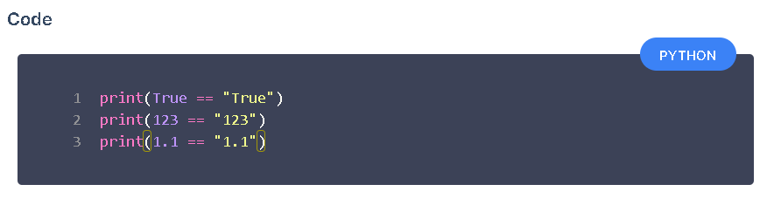
Strings and Equality Operator

